Slide 1
Objective 202.01 3%
Understand project management concepts used to create digital media.

Slide 2
Project Management
q Beginning a digital media project from scratch and carrying it through to its final completion takes a unified effort from all parties involved.
q Creating a Project Plan helps the process move forward quickly and efficiently. It helps the team avoid:
mistakes
arguments
tension within the team
wasted time

Slide 3
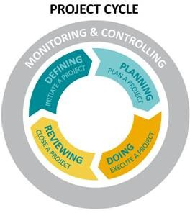
Project Management
Four stages in project management process:
Defining
Planning
Doing
Reviewing

Slide 4
Project Management
Defining
Defining a project is the opportunity to establish its elements and boundaries, so that the size and shape of the project and its outcomes are all understood and agreed upon before beginning work.

Slide 5
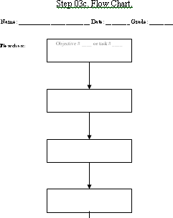
Defining: Flow Chart
Objective or Task
Steps to complete
Write Materials on the sides.

Slide 6
Project Management
Planning
Planning is an important step because the amount of time and energy dedicated to planning will correlate directly to how well the project stays on schedule, on budget, and how well it meets its goals.

Slide 7
Planning
q File requirements q File management q Color scheme
q Typography
q Logos/images created or located
q Script/Storyboard/Mock Layout created

Slide 8
Project Management
Doing
The core of the project is the execution—the implementation of the plans. In order to accomplish their goals, members will be monitoring their work, collaborating with team members, assessing their progress, and revising their project plans as necessary.

Slide 9
Doing
q Create needed project elements
q Compile and edit project
q Monitor schedule and task completion

Slide 10
Project Management
Reviewing
Reviewing is the opportunity to focus on the effectiveness of the team’s processes and the quality of the project deliverables. In this final stage, the focus is on assessing and celebrating the achievements of the entire project.

Slide 11
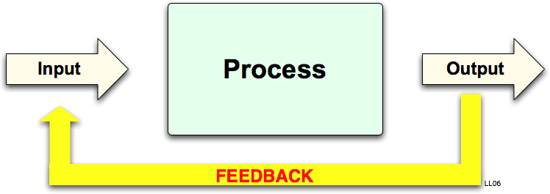
Reviewing
q Preview proofs
q Revise based on feedback
q Optimize files
q Publish in final format

Slide 12
Defining: Project Plan/Project Scope
q Some of the questions addressed include:
What do you do first?
What should come next?
Who will complete each task?
What resources do you need?
How long will it take?
When will the project be finished?
How will we know we are done with the project?

